Slide 1
Dinner and Discussion: Latest Trends in Colposcopy and Cervical Cancer
Chaired by: Professor Albert Singer
Speakers:
Prof. Charles Redman and Dr. Wojciech Homola

Slide 2



The cervical screening process has problems! test
It is often inaccurate
Pap Cytology is only approx. 70% accurate
with many false negative results
A positive HPV test indicates the presence of the virus: in only 10-16% is CIN present, leading to many unnecessary colposcopies and biopsy
VIA screening is highly subjective
Other tests?
Biomarkers ,accurate but expensive and presentat not at point of care
Lack of economic resources (90% of cases are in low-resource settings) and/or lack of trained providers
HPV virus
It is often inaccessible
Notes:
According to the CDC, approximately 79 million Americans are currently infected with HPV, with 14 million people newly infected each year. Nearly every american will contract HPV at some point in their lives.

Slide 3
REASONS FOR COLPOSCOPY
TO ASSESS ABNORMAL SMEAR AND/OR POSITIVE HPV
TO EXCLUDE INVASIVE CANCER IN A SUSPICIOUS CERVIX ; ASSESS ABNORMAL SYMPTOMS (P.C.B.: I.M.B. OR BLOOD STAINED DISCHARGE)

Slide 4
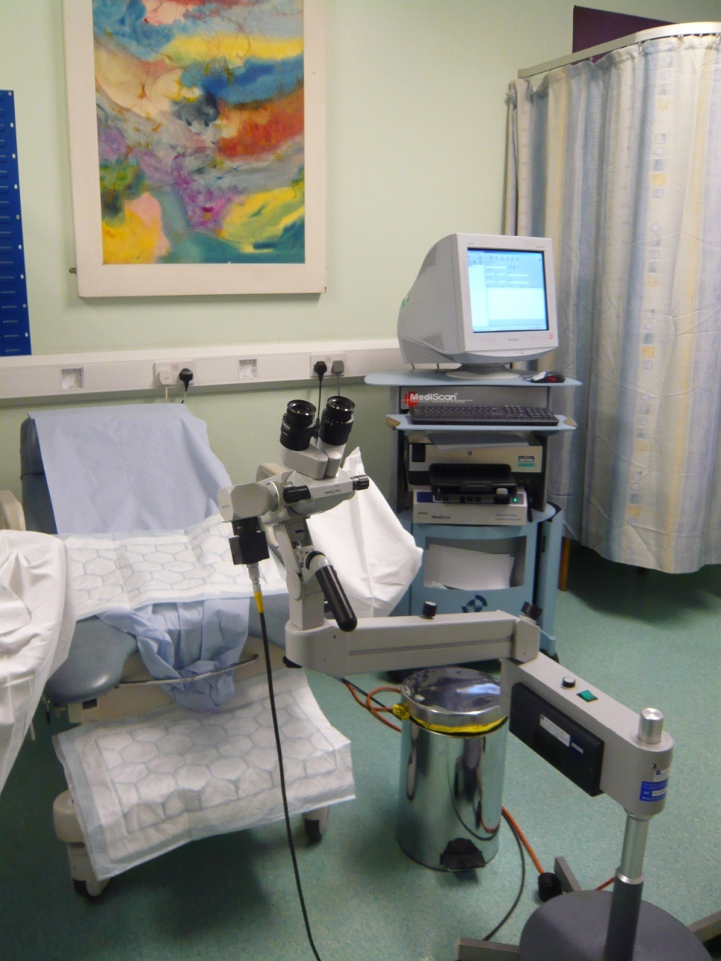
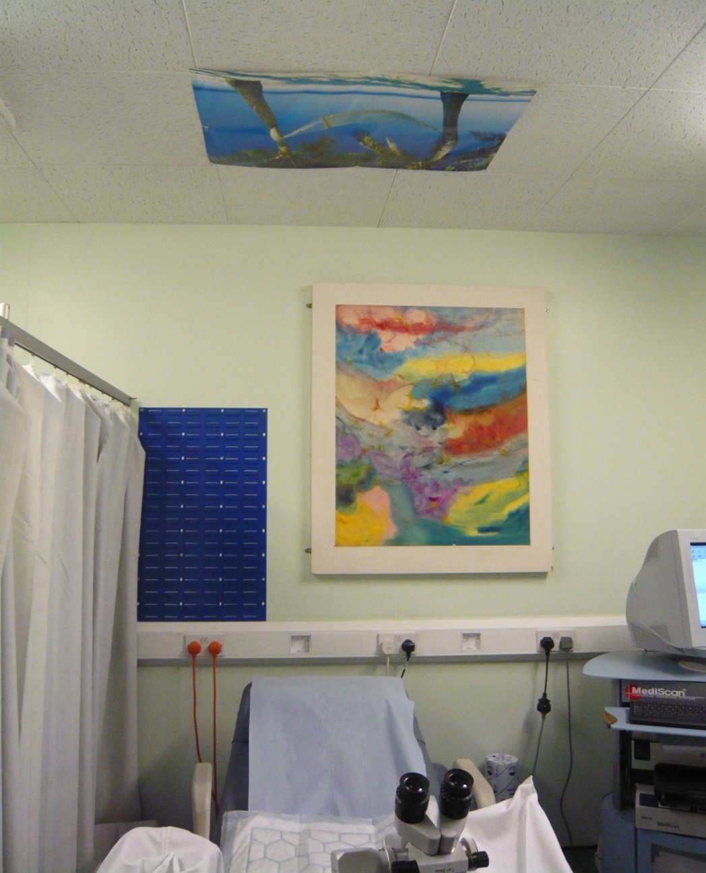
COLPOSCOPY CLINIC ARRANGEMENT

Slide 5
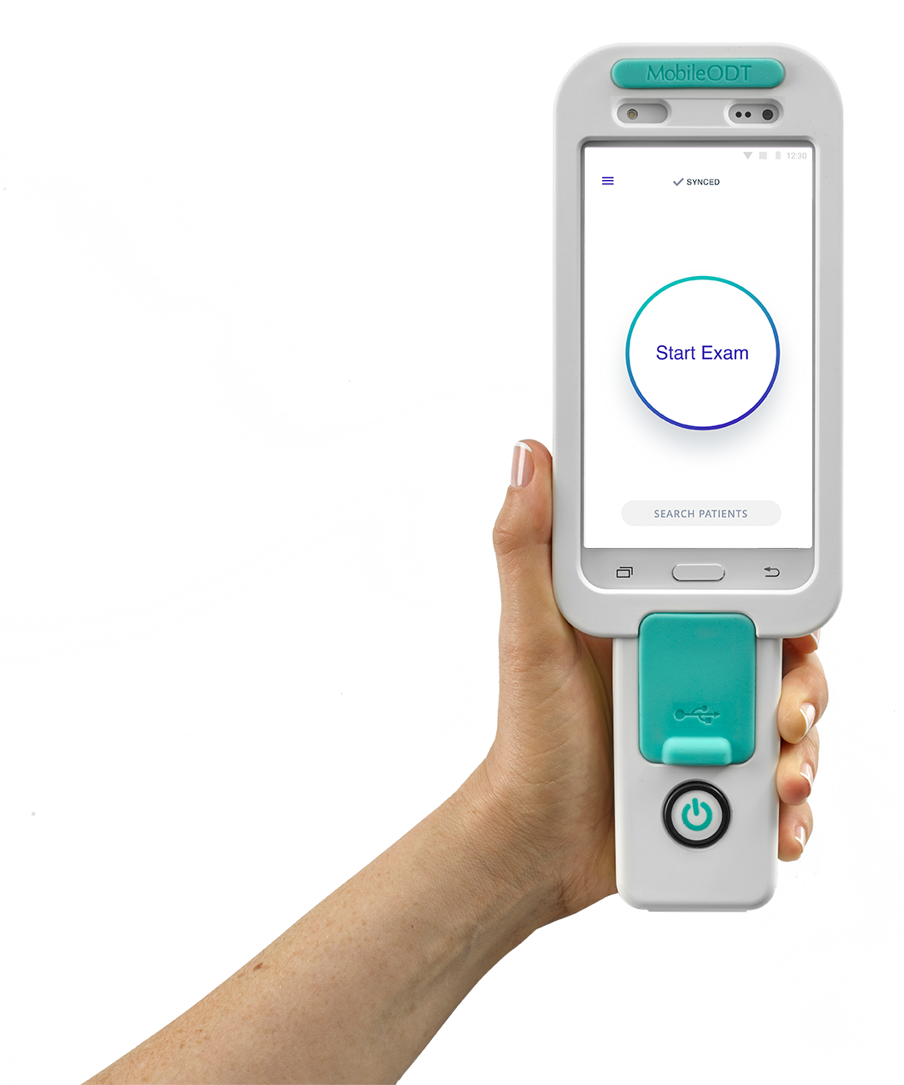
The EVA System
The EVA System addresses these challenges by providing AI (artificial intelligence) and mobile computing at the point of care.

Slide 6


THE EVA SYSTEM
A complete management solution

Slide 7
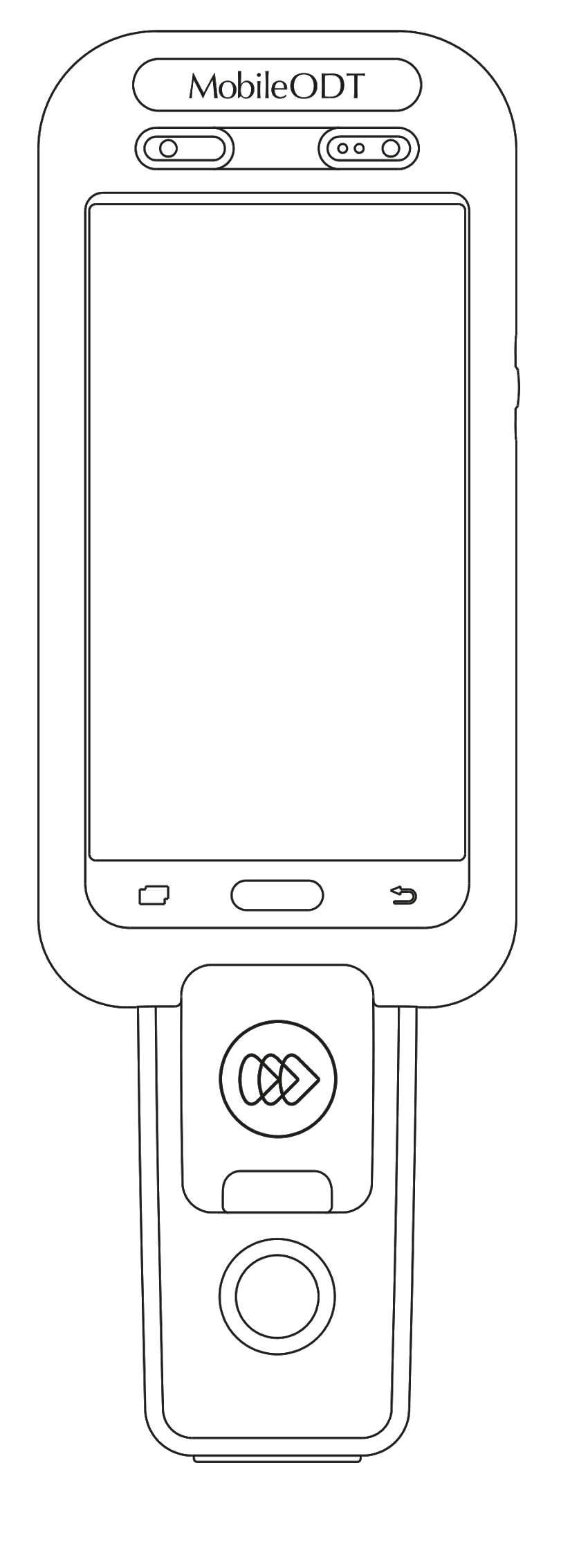

EVA - A smart visualization solution
EVA is a digital colposcope with the latest medical optics and mobile technology:
High resolution image and video
16x image magnification
Ultra LED light source with glare-reduction
Green and Red filters
Hands-free image capture
Wireless with rechargeable battery
Fully portable, with rolling stand
* FDA CLEARED,
CE MARKED

Slide 8
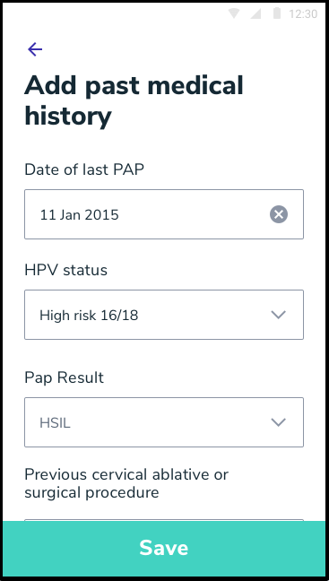


EVA - A documentation center
Streamline documentation and save time in every exam:
Easily record patient data and icompliant secure infrastructure
Direct email export of results and images to upload to your EMR
Automate the full procedure note with clinical scenarios for VIA, colposcopy, SAFE, and general gynecology
Manage your users and cases in the online internet portal from your desktop or tablet

Slide 9


EVA - A collaboration tool
Live teleconsultation from the app:
Offer advanced care and informed second opinion by streaming the examination securely to an off-site expert in real time
Oversee resident and trainee examinations through live mentoring and teleconsultation.
Expand services for colposcopy, forensic exams and general gynecology inside and outside your unit

Slide 10
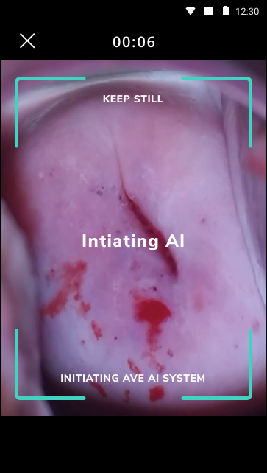

Augmented intelligence (AI)
The EVA system with (AI) is a point-of-care, cervical cancer screening test based on AVE* that evaluates the risk of cervical neoplasia with high accuracy. Provides an immediate answer for patient management
*AVE (Automated Visual Evaluation)

Slide 11
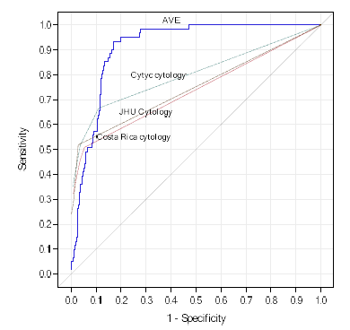

Automated Visual Evaluation (AVE)
“Automated Visual Evaluation performance was also statistically significantly more accurate than conventional Pap smears, liquid-based cytology, first-generation neural network-based cytology, and HPV testing”
AVE was validated by the US National Institute for Cancer which showed the potential to detect CIN2+with a simple image with over 90% accuracy.
An Observational Study of Deep Learning and Automated Evaluation of Cervical Images for Cancer Screening -
Hu L et al J Natl Cancer Inst. 2019 Sep 1;111(9):923-932

Slide 12
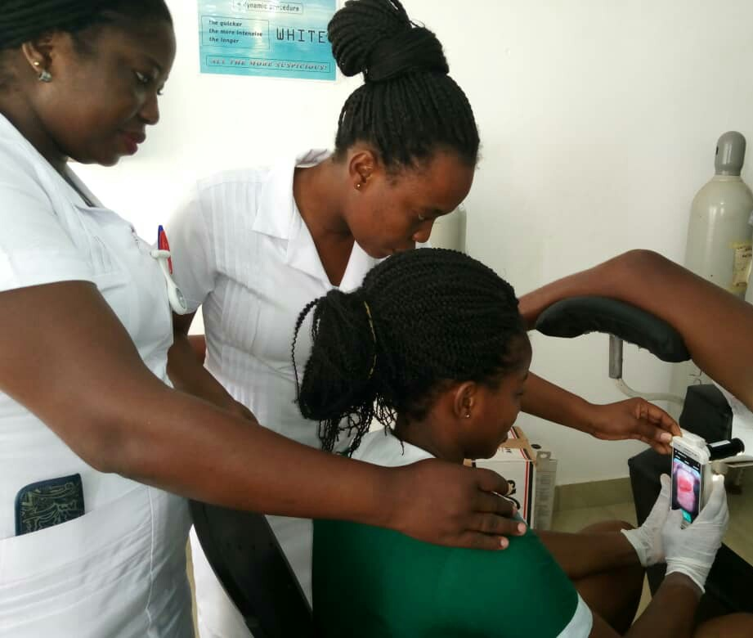
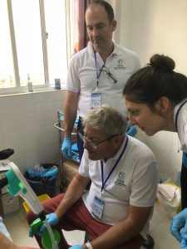

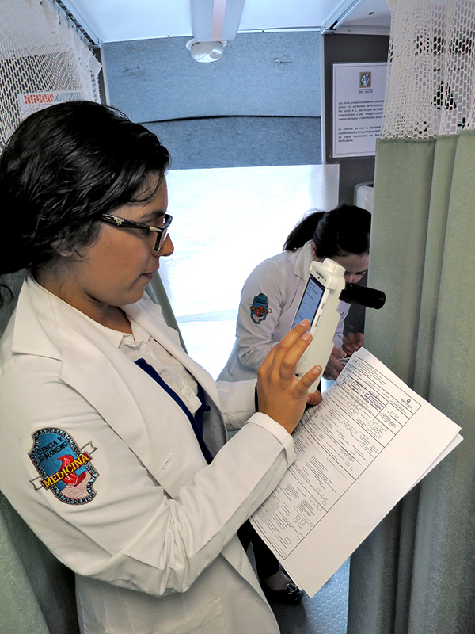
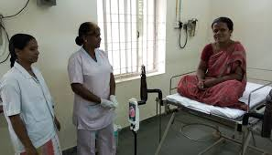

90% of Cervical cancer cases are in low-resource settings

Slide 13
Tonight’s topics for discussion:
Prof. Charles Redman - "Responding to Change: New Technology in QA and the State of Cervical Cancer Control in Eastern and Central Europe"
Dr. Wojciech Homola - "Artificial Intelligence Algorithm Performance on Real-World Data: AVE Case Study in Poland”

