Slide 1



Responding to changes
Professor Charles Redman

Slide 2
More women will die from cervical cancer than in childbirth

Slide 3
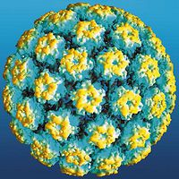

Slide 4

Elimination within the century
2030 targets
90% girls fully vaccinated with the HPV vaccine by 15 yrs
70% women screened at 35 and 45 years of age;
90% women with cervical disease receive treatment and care.
Increased coverage of screening/treatment of precancer lesions

Slide 5
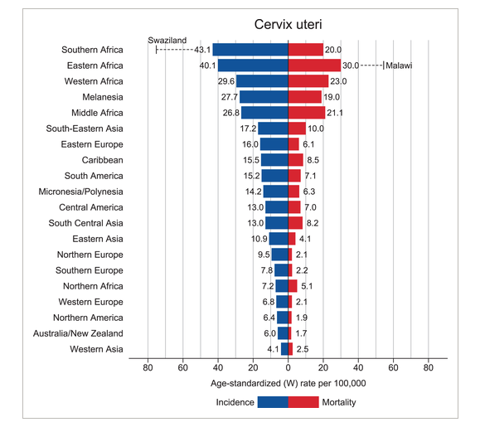
Cervical cancer
GLOBOCAN 2018

Slide 6
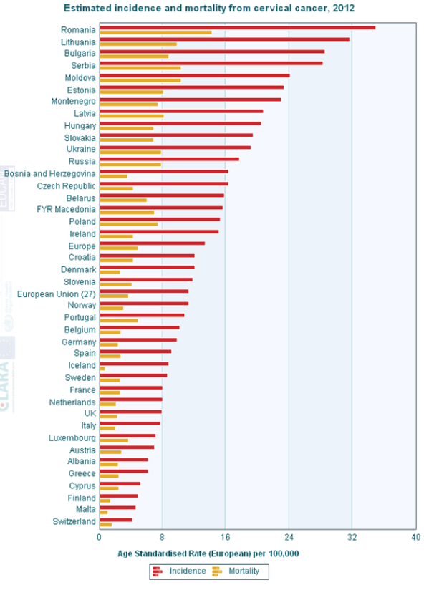
European Context

Slide 7
Data is collected periodically from across Europe
Invitation coverage for cervical screening of 7.6 - 105%
Dynamic situation
Dependent on who is reporting
Notes:
Orgnised population based programme
Defined target age
Defined screening interval
Organised quality assurance of all aspects
Monitoring and evaluation of effectiveness
Opportunistic screening
- Target women at risk in the desired time frame

Slide 8































Structure of screening program
Opportunistic screening
Organized, population based

Slide 9

Primary screening test
HPV
Liquid based cytology
HPV + cytology
Cytology + LBC
LBC + HPV
Cytology
Cytology + LBC + HPV

Slide 10
Country | Screening coverage | Outside of programme
Czech Republic | 55% | ?
Denmark | 75% | 10%
Estonia | 35% | 80%
Finland | 70% | 60%
France | 13% | ?
Hungary | <10% | ?
Iceland | 72-75% | 40%
Ireland | 72-75% | ?
Italy | 75% | 50%
Latvia | 59% | 41%
Lithuania | 40% | ?
Netherlands | 73-82% | 9%
Norway | 67-84% | Not applicable
Poland | 25% | 2/3rds
Romania | 20% | Not applicable
Slovenia | 72? | -
Sweden | 78-84% | 35%
UK | 74-80% | 14%
Screening coverage of national programmes
Notes:
The availability, quality and uptake of cervical cancer screening in these EE countries is variable. In many of these EE countries national organized screening programmes are relatively new compared to England, the earliest implementation of a national screening programme was only in 2002 in Hungary . Not all have rigorous quality assurance regulations compared to England where extensive Quality Assurance program underpins the NHS cervical screening program (NHSCSP) and ensures that standards of both cytology and colposcopy are maintained.
The availability of screening databases is variable and hence data on uptake is either not available or outdated. Where there is data available we can see that uptake is on the whole poor, ranging from less than 10% and a maximum of 72%.
The majority of healthcare is provided by private, independent gynaecologists there is yet to be regulation and quality control of the screening that women undergo. This is in contrast to the UKwhere an extensive Quality Assurance program underpins the NHS cervical screening program (NHSCSP) and ensures that standards of both cytology and colposcopy are maintained.

Slide 11
National HPV vaccination programme
2007 2008 2009 2010 2011 2012 2013 2014 2015 2016 2018
Year of initiation

Slide 13
Selection
Notes:
One of the objectives of colposcopy is to select and treat CIN3

Slide 14
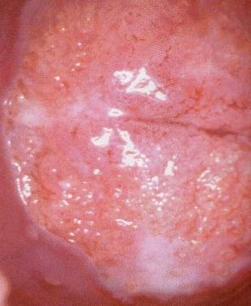
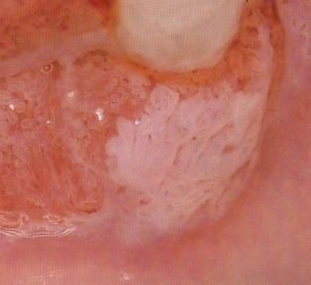
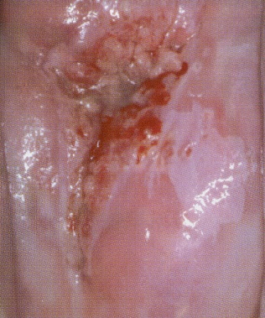
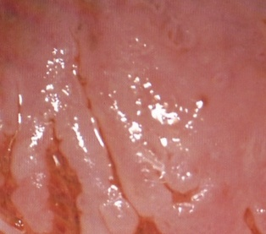
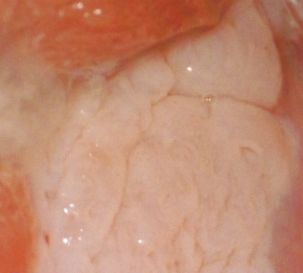
Acetowhitening
Metaplasia
CIN3
Density
Notes:
Colposcopic findings are well described and have an association with histological findings. However, there is considerable interobserver variation and the findings themselves are non-specific

Slide 15


Effect of Prevalence

Slide 16
Summary of challenges
Subjective and quantitative
Requires high specialization
High inter- and intra-observer disagreement
Low sensitivity
High biopsy sampling error rate

Slide 17
What can we do?
Number of biopsies
Additional random biopsies?
Improve quality of colposcopy?

Slide 18
Solutions
Training
Certification
Quality assurance
New technologies, including AI
Notes:
In addition to the above, one can consider other technologies other that conventional colposcopy. DYSIS which essentially quantifies aceto-whiteness, and Zedscan that uses electrical impedance to evaluate the cervical epithelium

Slide 19
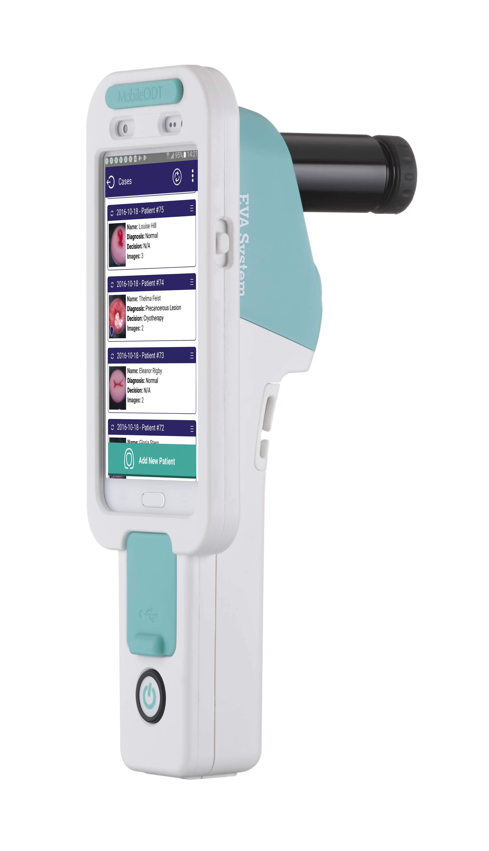
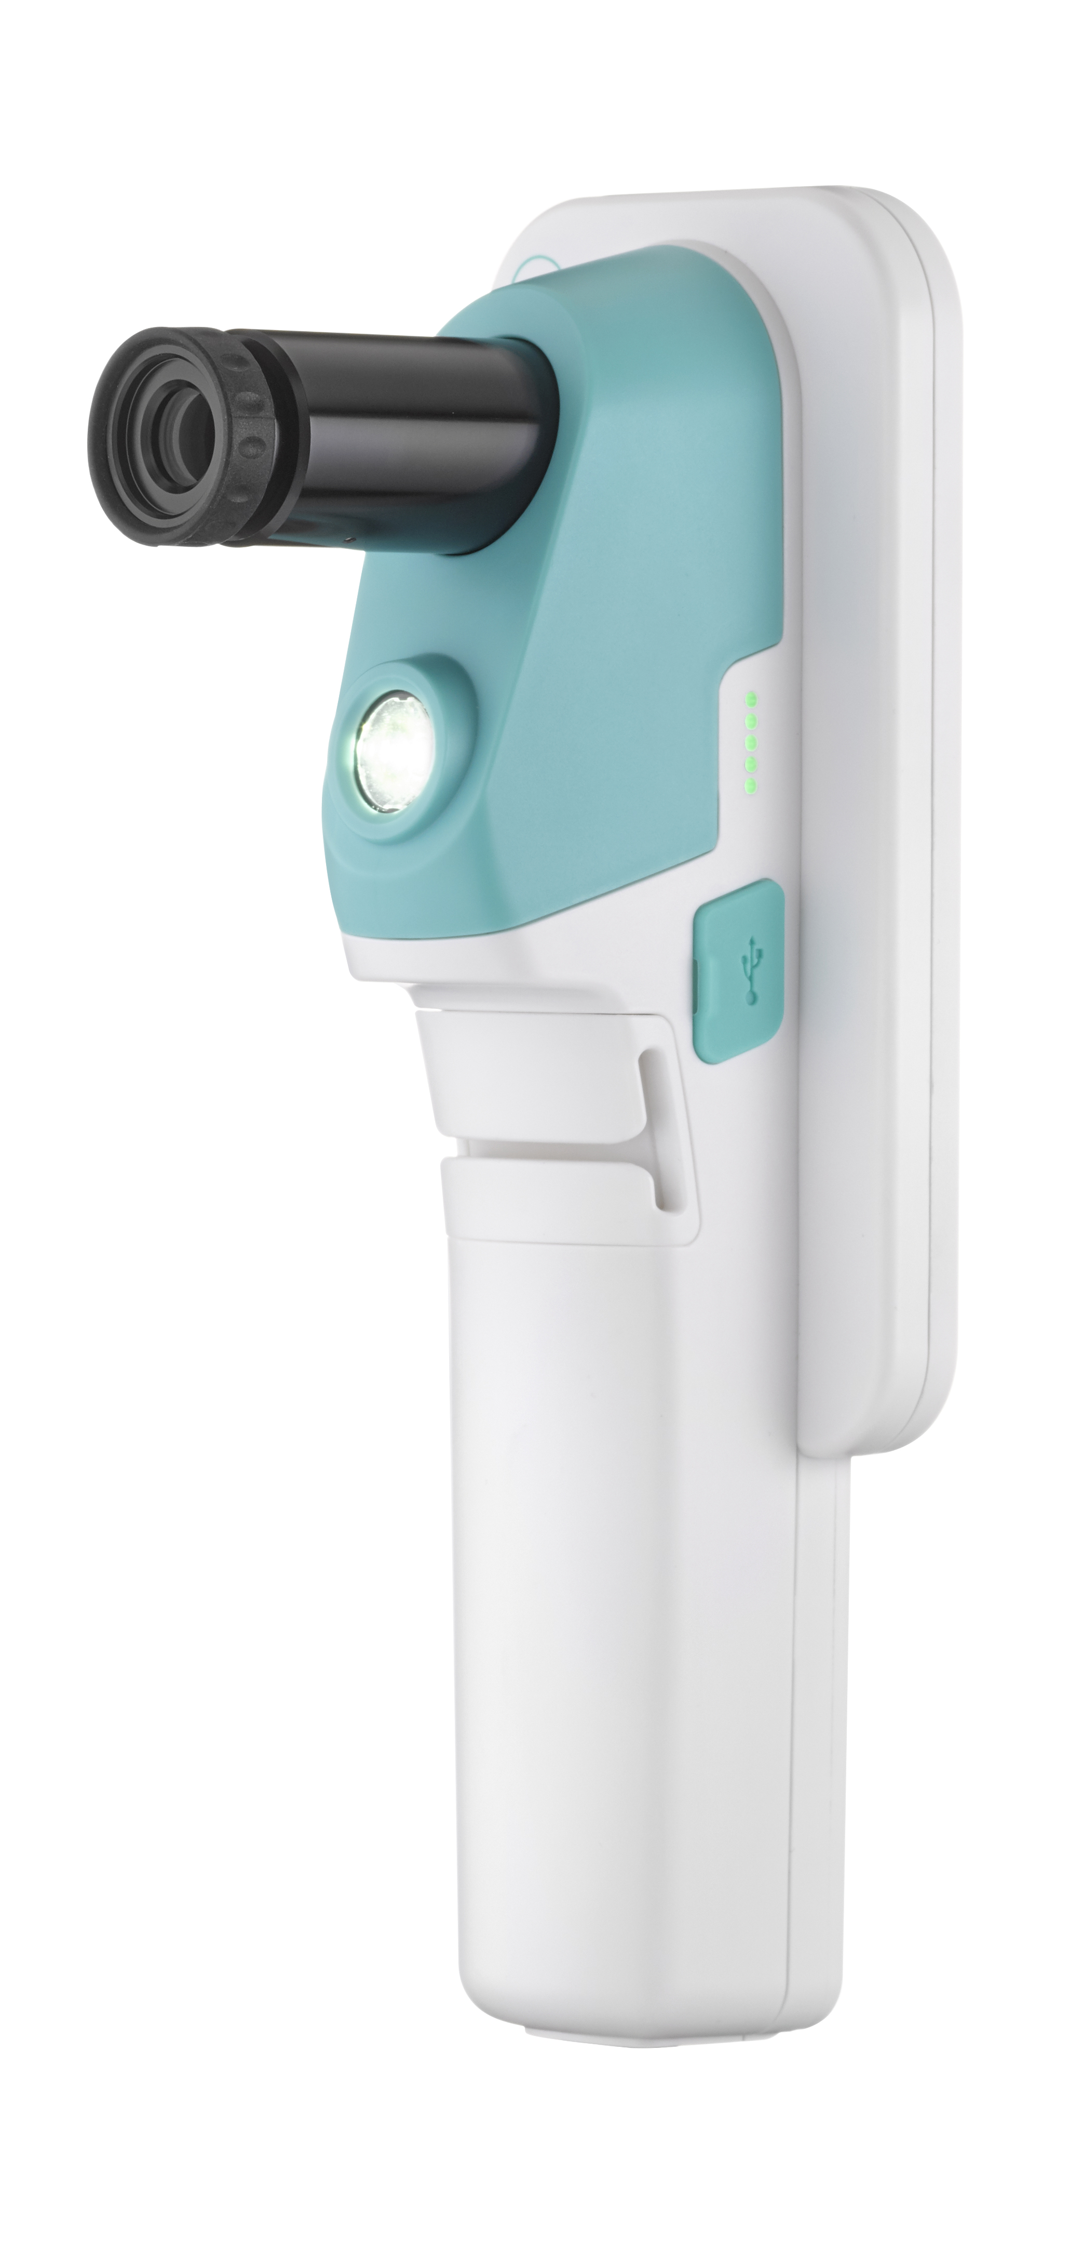
A potential solution ?

Slide 20
Summary
Geo-political
Organisation
Training
Certification trained colposcopists
Quality Assurance
New colposcopic technologies

