Slide 1
Evaluating the performance of an artificial intelligence classifier on a colposcopy population
W Homola¹, G Głąb², Z Wróbel³, Y Misrahi⁴, R Nissim⁴, C Sebag⁴, J Mink⁴, D Levitz⁴, M Zimmer¹
1. Uniwersytecki Szpital Kliniczny we Wrocławiu, Wrocław, Poland
2. Centrum Diagnostyki Ginekologiczno, Opole, Poland
3. „Medi-Lab” s.c. Wróbel i Wspólnicy, Świdnica, Poland
4. MobileODT Ltd., Tel Aviv, Israel

Slide 2
Disclosures
EUROGIN travel, accomodation and registration expenses: W. H. and M. Z. covered by MobileODT and associates
Y.M., J.M., C.S., R.N., D.L. are employees of MobileODT

Slide 3

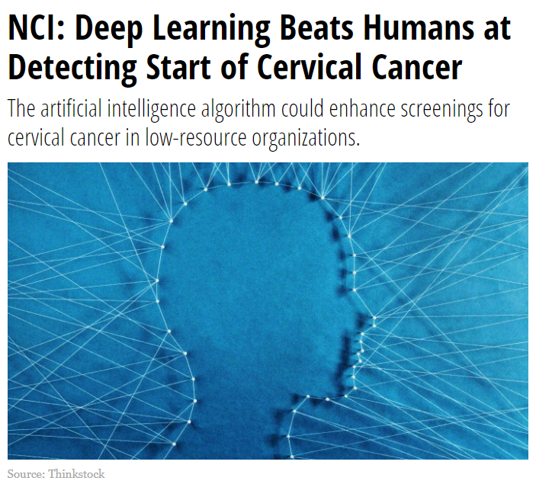
Objective: Assess Visual AI in a Triage Role
AVE: a promising new diagnostic test that uses AI to analyze cervical images
Unclear what is optimal role that AI will play in patient management
Objective: To evaluate potential of AI technology for the triage of screen positive patients
Jan 2019

Slide 4
Standard of care in Poland
Cytology
(conventional or LBC)
NILM
ASC_US / LSIL
ASC-H / HSIL
(patient chooses)
Repeat cytology
HPV test
p16 / Ki 67 dual stain
Colposcopy

Slide 5
Standard of care in Poland
Screening based on cytology ( majority: conventional pap smears)
Complete national cytology results data basis does not exist ( only those covered by NFZ )
Active screening does not exist currently
Opportunistic screening in private healthcare sector very popular
Updated guidelines are being prepared by specialist from both Polish Gynecologist & Obstetricians and Polish Colposcopy & Cervical Pathophysiology Association - 2020

Slide 6
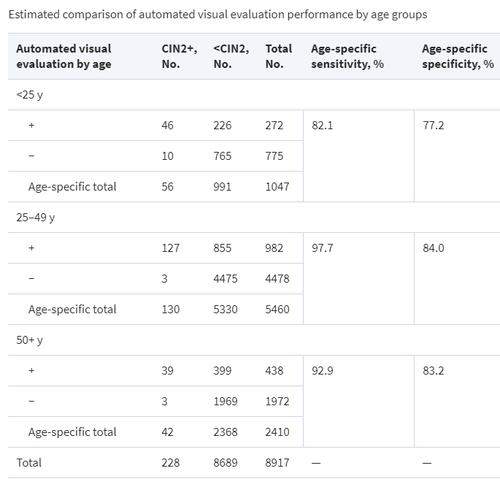
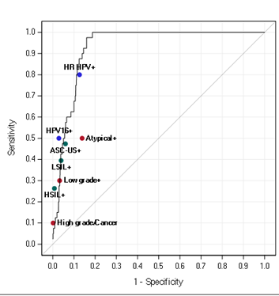
Potential Role of AI in Cervical Cancer Control
Automated Visual Evaluation (AVE) is a deep-learning algorithm applied on a visual image taken through a colposcope to recognize cervical precancer/cancer (CIN2 or worse)
AVE was validated by the US National Cancer Institute demonstrating the potential to detect CIN2+ from a single image with over 90% accuracy

Slide 7
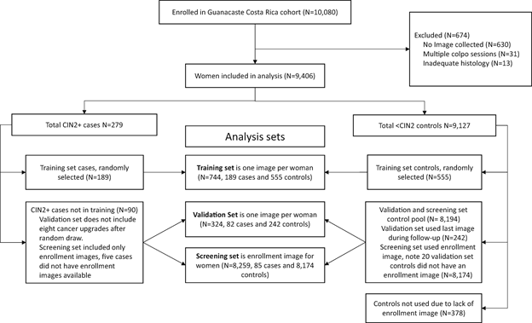
NCI AVE Study Design

Slide 8
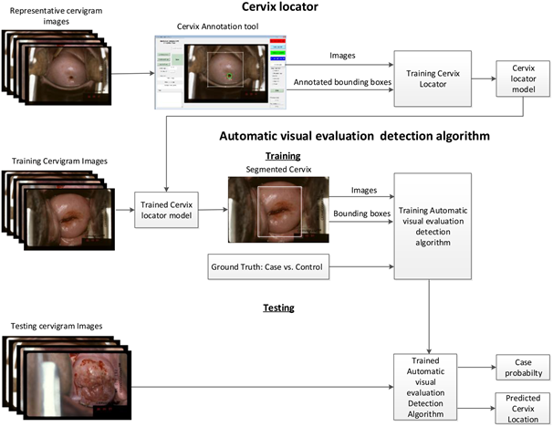
System Architecture of the NCI AVE Classifier
Notes:
Drawback of this AVE is that it was trained and validated on the same group of images, and they were cevicography images - not digital images

Slide 9
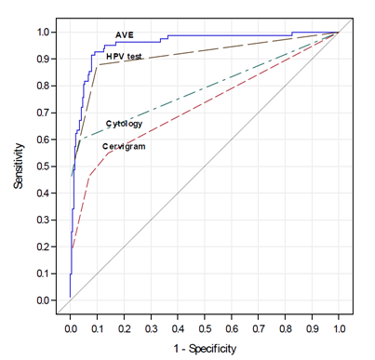
AVE Performance Vs Other Tests
Initial results of AVE from the US National Cancer Institute
Liming Hu, David Bell, Sameer Antani, Zhiyun Xue, Kai Yu, Matthew P Horning, Noni Gachuhi, Benjamin Wilson, Mayoore S Jaiswal, Brian Befano, L Rodney Long, Rolando Herrero, Mark H Einstein, Robert D Burk, Maria Demarco, Julia C Gage, Ana Cecilia Rodriguez, Nicolas Wentzensen, Mark Schiffman; An Observational Study of Deep Learning and Automated Evaluation of Cervical Images for Cancer Screening, JNCI: Journal of the National Cancer Institute, , djy225, https://doi.org/10.1093/jnci/djy225
Notes:
NCI only did work on cervicography images, so their AVE skeleton is not applicable to other devices, especially not digital images

Slide 10
Reconfiguring AVE on Digital Images
2 phases: classifier training, and classifier validation
Computer trained algorithm: histopathology + labels,
Emphasize and de-emphasize features,
  Emphasized features: i.e. acetowhitening,
  De-emphasized features: i.e. speculum color
Machine learning is dynamic- the more data that is inputted, the more accurate and robust it becomes
Notes:
only few features we emphasize/de-emphasized

Slide 11
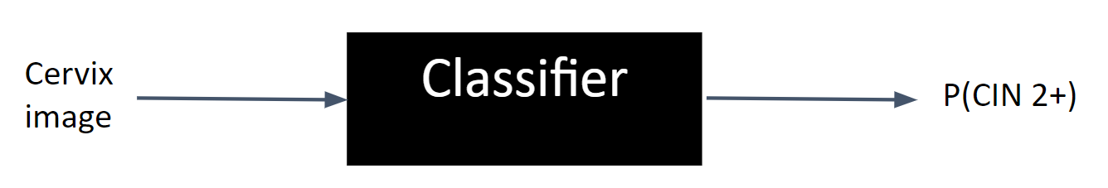
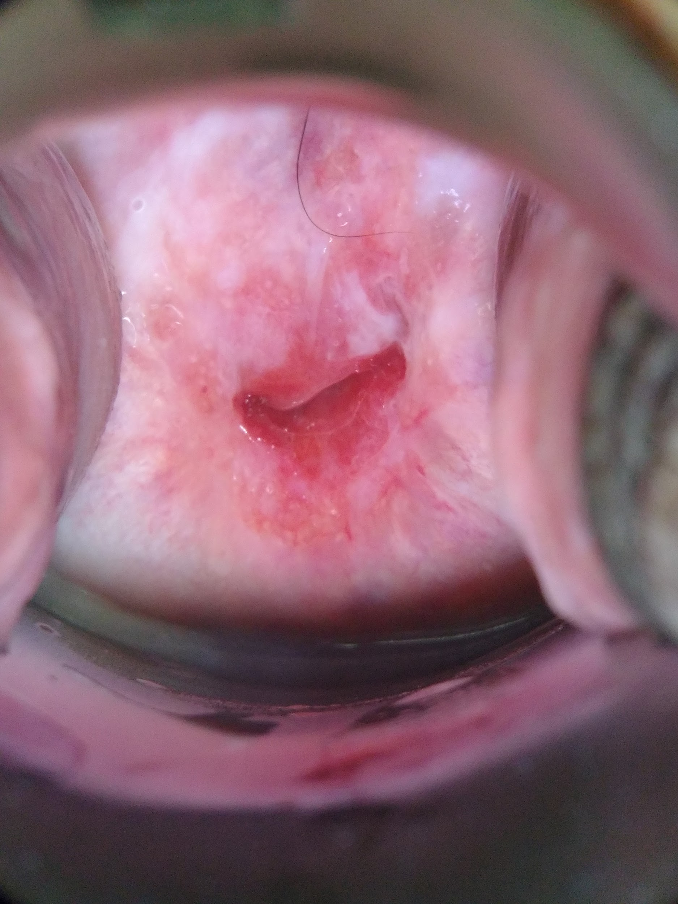
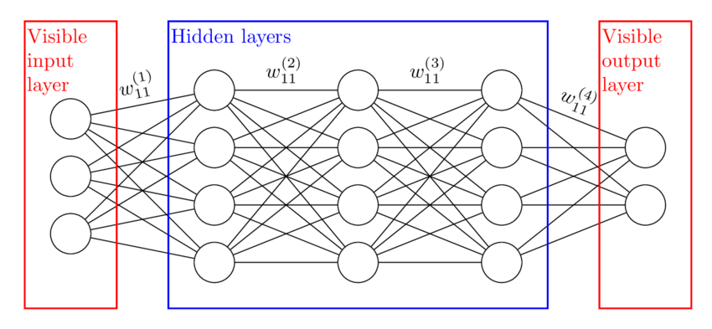
Reconfiguring AVE on Digital Images
Original image
Cropped, resized image (200x200 pixels)
Convolutional neural network
(black box)
Feature vector
Prediction score

Slide 12
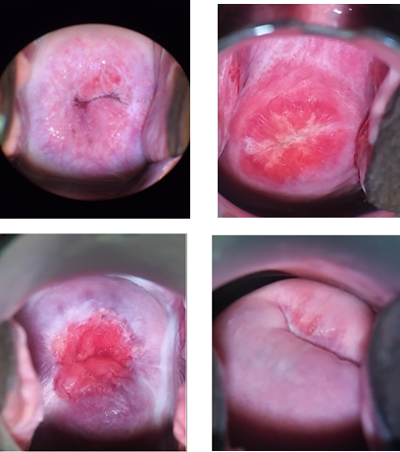
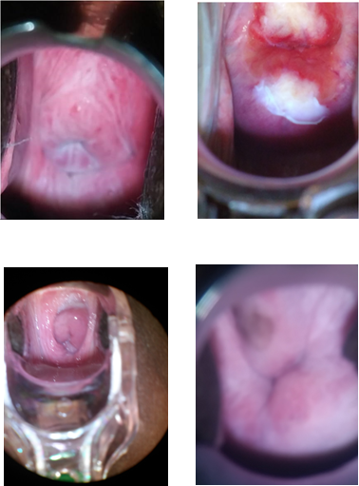
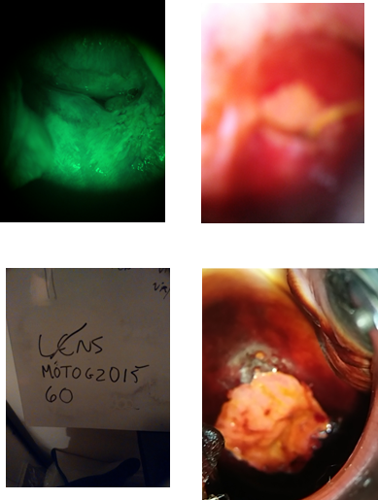
Qualifying Classifier
Purpose: select usable images for analysis from each patient session
3 class classifier: excellent, usable, background
Manual annotations
Training: 3724 images validation: 928
AUC > 0.95 (excellent vs. not excellent)
“Excellent”
“Usable”
“Background”

Slide 13
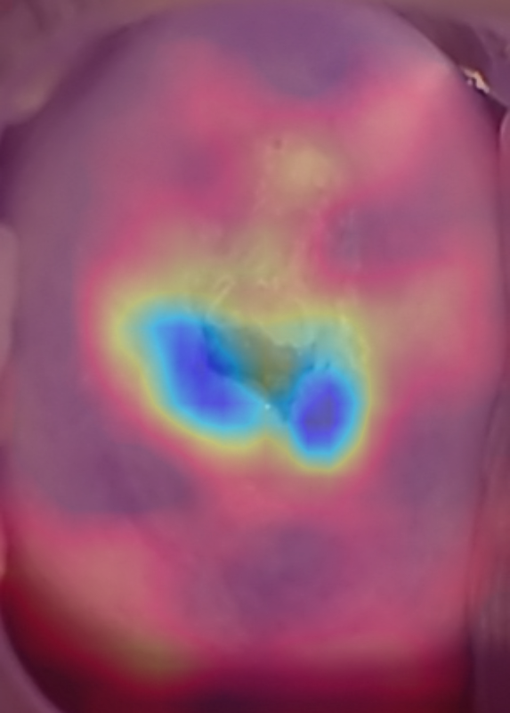
Arriving at a Prediction Score
AVE activation maps
Colposcopy session is performed with images captured
Run AI on session images
  Calculate quality score using qualifying classifier for each image
  Identify region of interest on the cervix
  Calculate AVE classifier score for each “excellent” image
AVE result takes weighted average of all AI above to arrive at a final prediction score
Blue corresponds to area on cervix that influenced the AVE prediction score

Slide 14
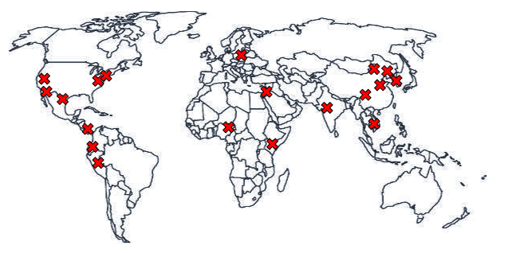
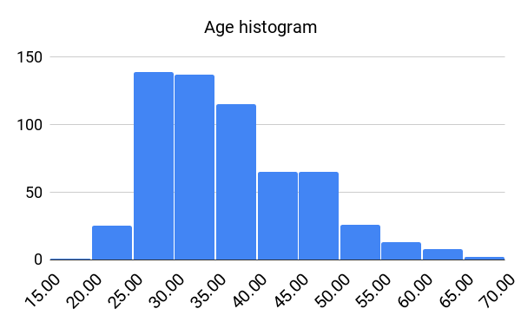
MobileODT AVE Classifier Specs
Biopsy collection sites
 | Training | Validation | Total
Normal | 242 | 136 | 378
Cervicitis | 123 | 65 | 188
CIN 1 | 188 | 107 | 295
CIN 2 | 205 | 122 | 327
CIN 3, Cancer, CIN 2/3 | 74 | 42 | 116
N = 1304 patients

Slide 15
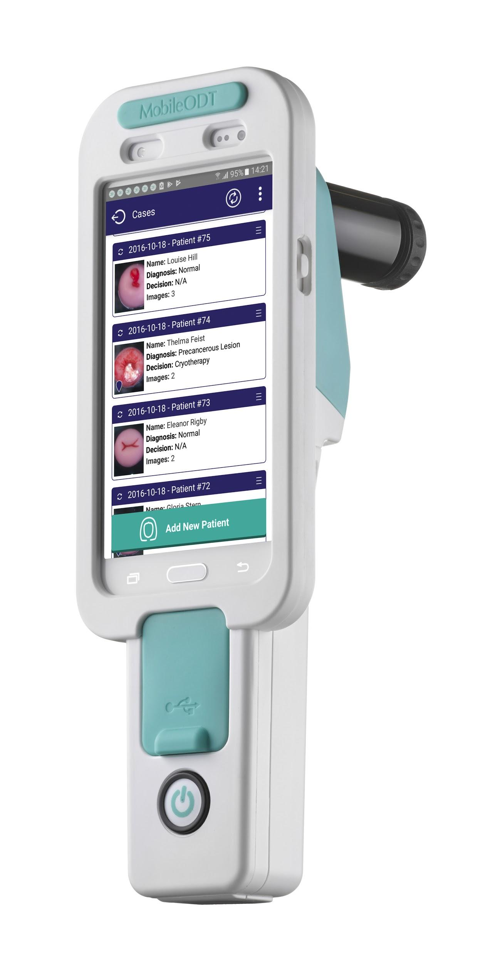

Polish Validation Study: Data Collection
Sites:
  Wroclaw
  Opole
  Zapolice
  Swidnica
Each site has 1-2 colposcopists
1 device / site
2 training sessions on using EVA
EVA System, v3.1

Slide 16
Study Design
Cytology
(conventional or LBC)
Retrospective cohort analysis of real world data
Patient enrollment at colposcopy
Opportunistic data gathering
AVE compared to histopathology
CIN 2+ defines positive
NILM
ASC_US / LSIL
ASC-H / HSIL
(patient chooses )
Repeat cytology
HPV test
p16 / Ki 67 dual stain
Colposcopy
Adjunct tests
(HPV, genotyping, p16, FRD, ZedScan)
Biopsies
Notes:
Secondary pathologiest opinion obtained

Slide 17
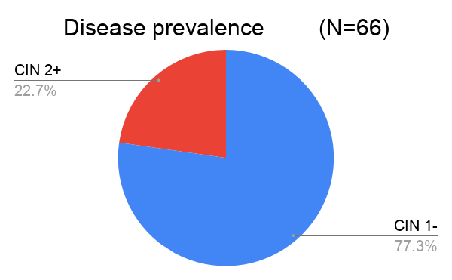
Test Population
N = 66 patients with digital images, full histopathology reports + secondary pathologist opinion

Slide 18
AVE Performance on Polish Validation Dataset
 | N= | Sens | Spec | PPV | NPV | Accuracy
AVE 1 | 66 | 0.533 (0.274-0.777) | 0.843 (0.709-0.925) | 0.500 (0.255-0.745) | 0.860 (0.726-0.937) | 0.773
AVE 2 | 66 | 0.267 (0.089-0.552) | 0.961 (0.854-0.993) | 0.667 (0.241-0.940) | 0.817 (0.691-0.900) | 0.803
LSIL Cytology | 66 | 0.947 (0.719-0.997) | 0.281 (0.179-0.410) | 0.281 (0.179-0.410) | 0.947 (0.719-0.997) | 0.434
HPV | 37 | 1 (0.732-1.000) | 0.435 (0.239-0.651) | 0.519 (0.323-0.708) | 1 (0.655-1.000) | 0.649
AVE can be used to triage HPV effectively
Notes:
AVE can be adjusted to enable higher sensitivity or higher specificity, this allows the user to set a threshold for the desired performance

Slide 19
Role of AVE as Triage with HPV in Poland
When compared with histopathology, Cytology results had very high sensitivity and low specificity
  Very similar sensitivity and specificity to HPV - There is a questionable benefit of 2 highly sensitive, but not specific, diagnostic tests
Optimal triage test should be designed for high specificity
AVE can be adjusted to enable higher sensitivity or higher specificity, this allows the user to set a threshold for the desired performance
  When combined with HPV, AVE can serve as a strong triage test, complimenting HPV’s high sensitivity and need for a high specificity test

Slide 20
Limitations of the study
Real world data: Several labs were used to analyze test results, rather than a single lab with a standard reader panel. Only one site provided slides for a reader panel.
Opportunistic data gathering: not possible to compare all test results on all patients
Variation in image quality: multiple users and settings
Unclear how performance will change on different populations. ex. HPV-
Notes:
But for the vast majority of cases we have obtained secondary pathologiest opinion ( based on full biopsy digital slides)

Slide 21
Interpretation and Conclusions
Pilot obtained a range of real-world digital images and found good AVE sens, spec, PPV, NPV and accuracy
Prototype of digital AVE running on the EVA System shows promise: A lab-free test providing results at the point of care which could be a reality soon and potentially reduces loss of follow up’s
AVE has good prognostics for useful tool in triage for HPV positive patients and/or supplementary technology in co-test with cytology and/or HPV testing
Multi-centered, RCT on statistically significant population is needed for complete assessment of AVE as a diagnostic tool

Slide 22
Questions?
Dr. Wojciech Homola
wojciech.homola@umed.wroc.pl

Slide 23

Thank you!
Dr. Wojciech Homola
wojciech.homola@umed.wroc.pl
Notes:
Wrocław: European Capitol of Culture 2016
Wrocław: European Best Destination 2018

Slide 24
Citations
Zimermman G, Gordon S, Greenspan H, editors. Content-based indexing and retrieval of uterine cervix images. 2004 23rd IEEE Convention of Electrical and Electronics Engineers in Israel; 2004 September 6-7, 2004; Tel Aviv, Israel: IEEE.
Acosta-Mesa HG, Cruz-Ramirez N, Hernandez-Jimenez R. Aceto-white temporal pattern classification using K-NN to identify precancerous cervical lesion in colposcopic images. Comput Biol Med. 2009 Sep;39:(9):778-84. (http://www.ncbi.nlm.nih.gov/pubmed/19608162).
Acosta-Mesa HG, Rechy-Ramirez F, Mezura-Montes E, Cruz-Ramirez N, Hernandez Jimenez R. Application of time series discretization using evolutionary programming for classification of precancerous cervical lesions. J Biomed Inform. 2014 Jun;49:73-83. (http://www.ncbi.nlm.nih.gov/pubmed/24637143).
Acosta-Mesa HG, Zitova B, Rios-Figueroa HV, Cruz-Ramirez N, Marin-Hernandez A, Hernandez-Jimenez R, et al., editors. Cervical cancer detection using colposcopic images: A temporal approach. Sixth Mexican International Conference on Computer Science (ENC'05); 2005 September 26-30, 2005; Puebla, Mexico: IEEE.
Xu T, Zhang H, Xin C, Kim E, Long LR, Xue Z, et al. Multi-feature based benchmark for cervical dysplasia classification evaluation. Pattern Recognition. 2017 Mar;63:468-75. (http://www.ncbi.nlm.nih.gov/pubmed/28603299).
Hu L, Bell D, Antani S, Xue Z, Yu K, Horning MP, et al. An observational study of deep learning and automated evaluation of cervical images for cancer screening. JNCI: Journal of the National Cancer Institute [serial on the Internet]. 2019. (https://doi.org/10.1093/jnci/djy225).
Fernandes K, Cardoso JS, Fernandes J, editors. Transfer learning with partial observability applied to cervical cancer screening. IbPRIA 2017: Pattern Recognition and Image Analysis: Lecture Notes in Computer Science [from the 8th Iberian Conference on Pattern Recognition and Image Analysis (IbPRIA 2017)]; 2017 June 20-23, 2017; Faro, Portugal: Springer, Cham.
Herrero R, Schiffman MH, Bratti C, Hildesheim A, Balmaceda I, Sherman ME, Greenberg M, Cárdenas F, Gómez V, Helgesen K, Morales J. Design and methods of a population-based natural history study of cervical neoplasia in a rural province of Costa Rica: the Guanacaste Project. Revista Panamericana de Salud Pública. 1997;1:362-75. (PMID: 9180057)
Schneider DL, Herrero R, Bratti C, Greenberg MD, Hildesheim A, Sherman ME, Morales J, Hutchinson ML, Sedlacek TV, Lorincz A, Mango L. Cervicography screening for cervical cancer among 8460 women in a high-risk population. American journal of obstetrics and gynecology. 1999 Feb 1;180(2):290-8. (https://doi.org/10.1016/S0002-9378(99)70202-4)
Singer A, Khan A. Singer and Monaghan's Cervical and Lower Genital Tract Precancer: Diagnosis and Treatment. John Wiley & Sons; 2014 Jun 3.

